Slide 1
DJANGO FUN
By: Justin Rodriguez

Slide 2

Introduction
USER REGISTRATION AND LOGIN BRIEF OVERVIEW
INTRODUCTION TO MEDIA AND IMAGES IN DJANGO
ISSUES- SUCCESS
RESOURCES

Slide 3
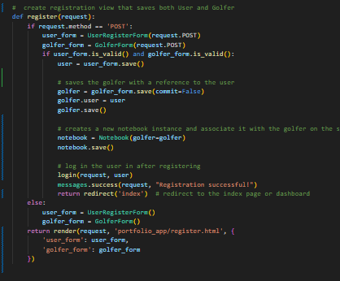
USER REGISTRATION AND LOGIN OVERVIEW
User Registration
User Login
Handled in the register view
Gather users' details UserRegisterForm and GolferForm
Registration complete automatically creates golfer and notebook
Once successful registration sends to home page logged in
Manage with user login view
Validates using UserLoginForm
Uses Django prebuilt authenticate and login to establish the user session
Redirects to homepage after valid login

Slide 4
OVERVIEW IMPORTING FILES
File Fields in Models: Handles the uploading of the files, storage and specifying paths
Forms for File Input: Gives user an option to select files and upload through the web interface
Handling File Uploads in Views: Views in view.py they handle the logic of CRUD from forms –> server
File Storage Configuration: Designate where uploaded files are stored and accessed ( MEDIA_ROOT & MEDIA URL)
Secure File Handling: Limits possibility of users uploading incorrect file and possibly malware.
Serving Files: Add configures to urls.py in the Django Project, allows for user files user uploaded files to be served during development

Slide 5
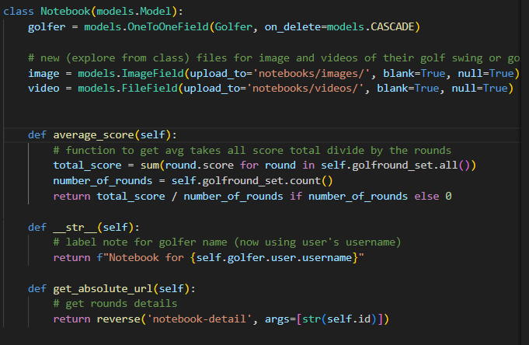

INCORPORATING MEDIA IN THE PROJECT
Storing Media: Includes fields for storing files in the Notebook model
Media Upload Paths: Files are uploaded to MEDIA_ROOT
Flexible Media Fields: Using blank = True ensures the user can use any media file
Accessible URLS: Automatic by Django making it easy to display/retrieve

Slide 6
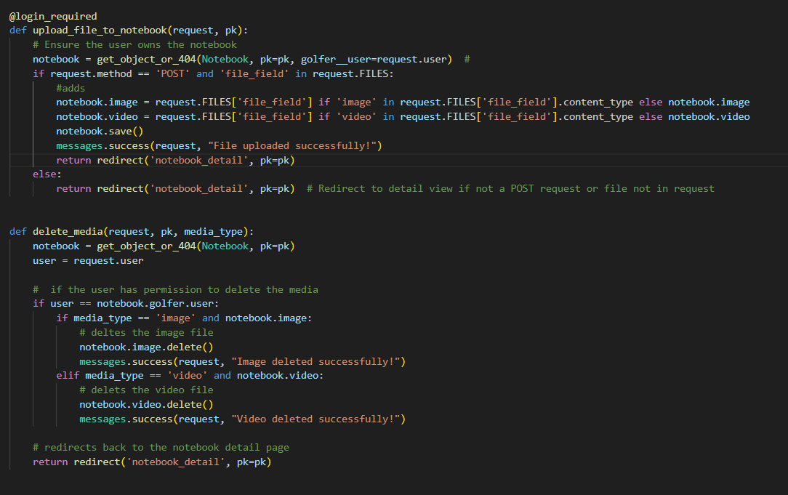
MEDIA UPLOAD AND DELETION
Upload Process: : upload_file_to_notebook, checks for file’s content type then assigned it to the correct field before saving
Logic for Files Types: inside the view, allows for conditional logic to determine if it’s video or an image
Deletion Process: delete_media, allows authorized (owner) user to delete their media post
User Feedback & Redirection: CRUD operation performed, redirect to the correct redirect in this case it’s notebook_detail

Slide 7
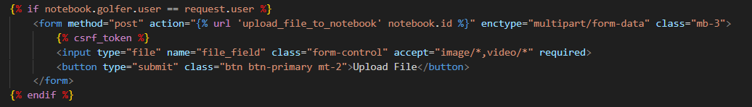
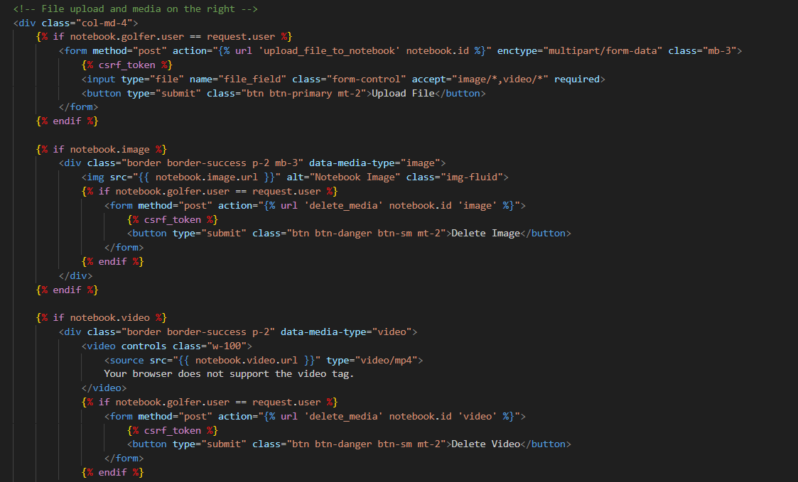
FILE HANDLING FORMATTING
Media Display: presentation of the code, handled by a template
Uploading Media: golfers are presented a eye appealing view, while the code in views.py is doing all the work behind the scenes
Media Deletion: Deletion of videos and images, by using submissions forms, and handles the logic behind in the view.py.
User Feedback: Messages based on success or error after an action is done.

Slide 8
ISSUES & SUCCESS
ISSUES
SUCCESS
Permission Checks: user permission verification
Form Error Handling: when creating a new user, didn’t actually create a user
Media Deletion 404: Missing media leads to a 404 error.
Upload Update: New upload doesn't replace existing media.
Bad Redirects: actions leads to, redirects fail or incorrect pages
Didn’t get to figure my extra leaderboard ( will do that on my own)
Media/File Handling: Working and can perform crud
Styling: got more creative with bootstrap
Accessibility: Updated a lot of small stuff to ensure a friendly experience
User Authentication: log/sign in work and can only perform crud to their respectable notebook.
Have a full app that works great!

Slide 9
Resources
https://djangocentral.com/managing-media-files-in-django/#:~:text=,join%20%28BASE_DIR%2C%20%27media
https://www.youtube.com/watch?v=lKyH_ZGtvwM
https://testdriven.io/blog/django-static-files/
https://stackoverflow.com/questions/6418072/accessing-media-files-in-django
https://stackoverflow.com/questions/40206569/django-model-doesnt-declare-an-explicit-app-label.
https://ordinarycoders.com/blog/article/django-file-image-uploads
Secure mobile clouding class (very useful)

